Slide 1
Chapter 5
Web Form Fundamentals

Slide 2
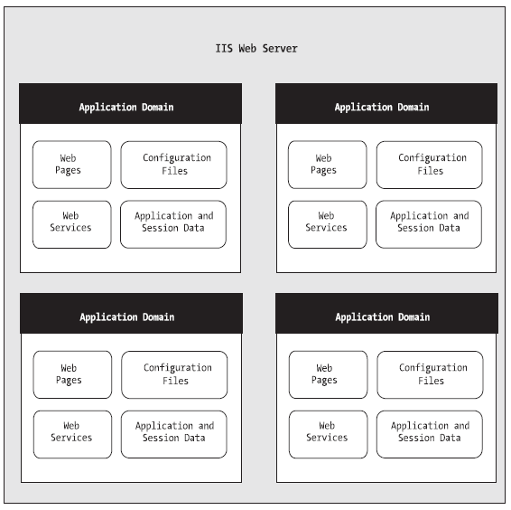
ASP.NET applications

Slide 3
ASP Files Types
Ends with .aspx
These are ASP.NET web pages
Ends with .ascx
These are ASP.NET user controls.
Ends with .asmx
These are ASP.NET web services—collections of methods that can be called over the Internet.
web.config
This is the XML-based configuration file for your ASP.NET application. It includes settings for customizing security, state management, memory management, and much more.
Global.asax
This is the global application file. You can use this file to define global Variables
Ends with .cs
These are code-behind files that contain C# code.

Slide 4
ASP.NET Application Directories
Bin
Contains all the compiled .NET components (DLLs) that the ASP.NET web application uses.
App_Code
Contains source code files that are dynamically compiled for use in your application.
App_Global
Resources Stores global resources that are accessible to every page in the web application.

Slide 5
ASP.NET Application Directories
App_LocalResources
Serves the same purpose as App_GlobalResources, except these resources are accessible to a specific page only.
App_WebReferences
Stores references to web services that the web application uses.
App_Data
Stores data, including SQL Server 2005 Express Edition database files and XML files. Of course, you’re free to store data files in other directories.
App_Themes
Stores the themes that are used by your web application. You’ll learn about themes in Chapter 13.

Slide 6
HTML Server Controls
HTML server controls provide an object interface for standard HTML elements. They provide three key features:
They generate their own interface:
They retain their state
They fire server-side events:

Slide 7
Converting an HTML Page to an ASP.NET Page
<!DOCTYPE html>
<html>
<head>
<title>Currency Converter</title>
</head>
<body> <form method="post">
<div> Convert:&nbsp; <input type="text" /> &nbsp;U.S. dollars to Euros. <br /><br /> <input type="submit" value="OK" />
</div>
</form>
</body>
</html>

Slide 8
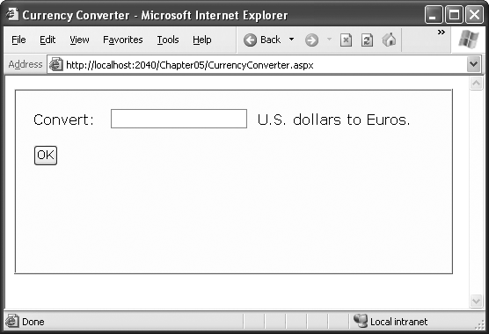
Currency Converter

Slide 9
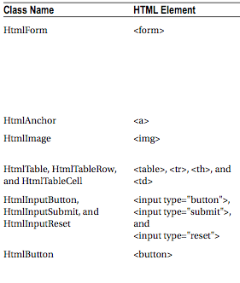
HTML Control Classes

Slide 10
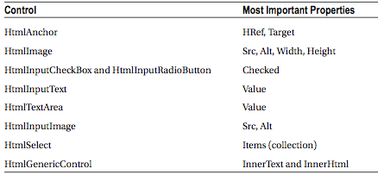
Important HTML Control Properties

Slide 11
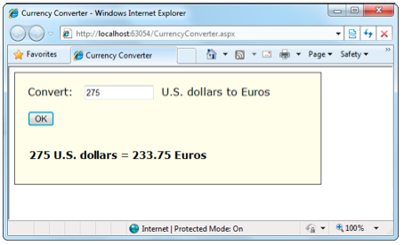
ASP Currency converter

Slide 12
Error Handling
decimal USAmount; // Attempt the conversion.
bool success=Decimal.TryParse(US.Value, out USAmount);
// Check if it succeeded.
if (success) {
…
} else {
…
}

Slide 13
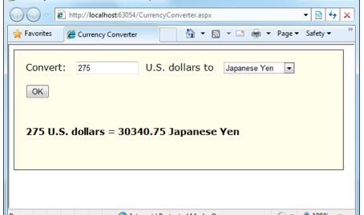
Multicurrency Converter

Slide 14
Setting Styles
if ((oldAmount<= 0) || (success == false))
{
Result.Style[“color”] = “Red”;
Result.InnerText=“Specify a positive number”;
}
else
{
…
}

Slide 15
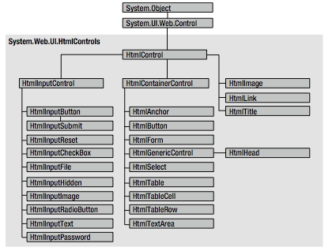
Deeper Look at HTML Control Classes

Slide 16
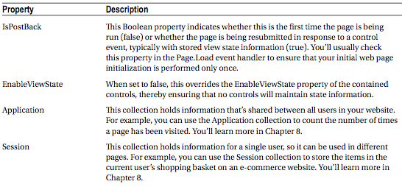
Using the Page Class

Slide 17
Sending the User to a New Page
Hyperlink
Click <a href="newpage.aspx">here</a> to go to newpage.aspx.
Response inside project
Response.Redirect("newpage.aspx");
Response to new website
Response.Redirect("http://www.prosetech.com");
Server
Server.Transfer("newpage.aspx");

Slide 18
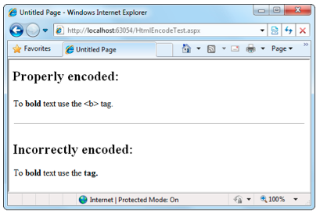
Server.HtmlEncode( )

